Slide 1
Menus in Android
By : Prof. Brijesh Patel

Slide 2
Menus are a common user interface component in many types of applications.
To provide a familiar and consistent user experience, you should use the Menu APIs to present user actions and other options in your activities.

Slide 3
Options menu and app bar
The options menu is the primary collection of menu items for an activity.
It's where you should place actions that have a global impact on the app, such as "Search," "Compose email," and "Settings."

Slide 4
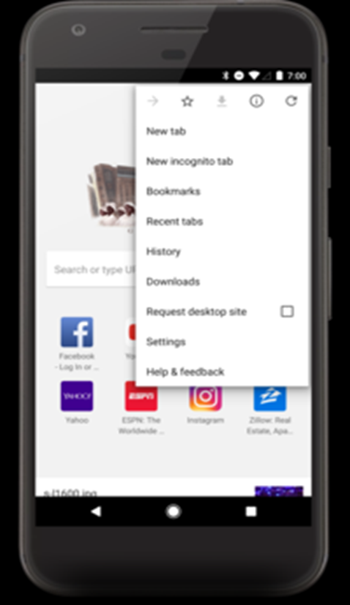

Slide 5
Context menu and contextual action mode
A context menu is a floating menu that appears when the user performs a long-click on an element. It provides actions that affect the selected content or context frame.
The contextual action mode displays action items that affect the selected content in a bar at the top of the screen and allows the user to select multiple items.

Slide 6
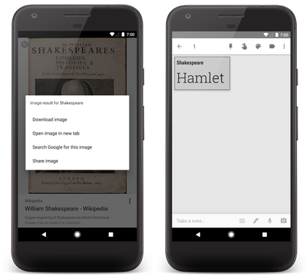

Slide 7
Popup menu
popup menu displays a list of items in a vertical list that's anchored to the view that invoked the menu.
It's good for providing an overflow of actions that relate to specific content or to provide options for a second part of a command. Actions in a popup menu should not directly affect the corresponding content—that's what contextual actions are for.

Slide 8
